Slide 1

Some EDR Ramblings and How to write a Loader
Arun George Jose

Slide 2


AV vs EDR

Slide 3
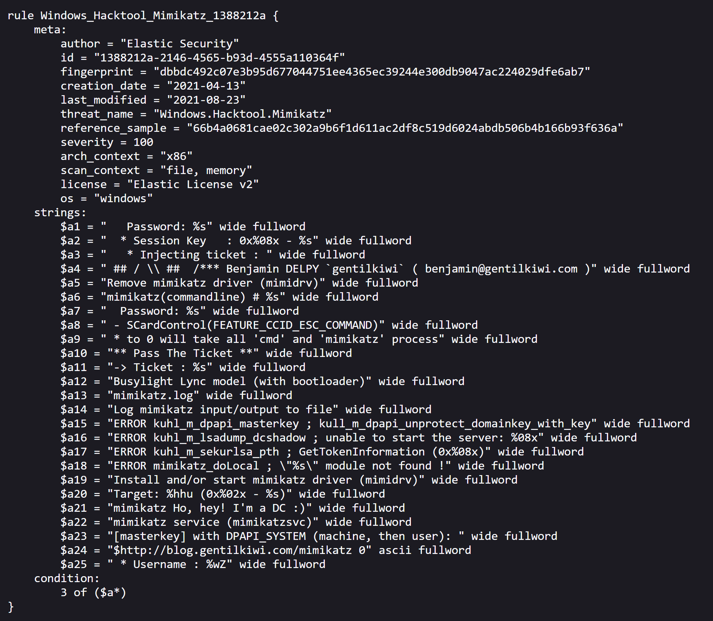
AV
IOC based detection (old)
Signature based detection (new – more powerful than you think) – static and dynamic

Slide 4
EDR – Endpoint Detection & Response
Advanced Signature Based Detection
Behavior Based detection
Opening handles to suspicious process – eg beacon.exe - > lsass.exe
Registry changes - eg startup, autorun, fodhelper
Abnormal command execution – net.exe , schtask.exe
Network traffic made by a process
Etc
Memory Based detection
Newly created region with RWX permission
Private commits
Etc

Slide 5

Win32 API, NT Calls

Slide 6
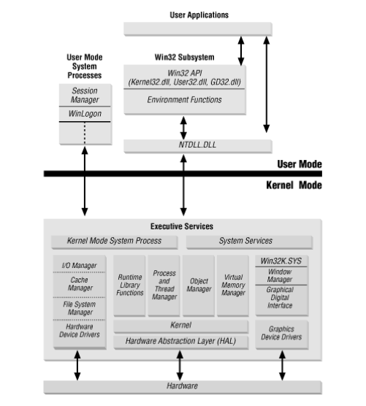
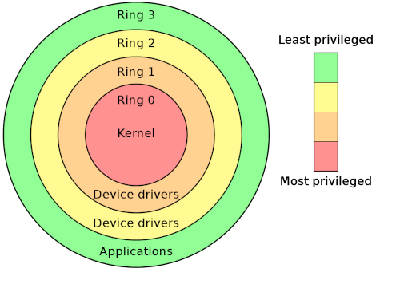
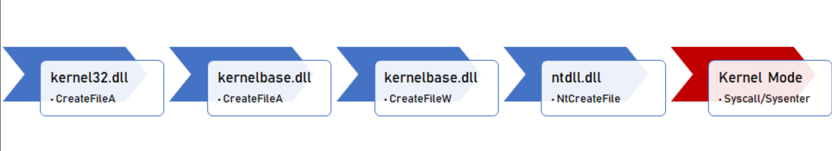

Slide 7

Some EDR Telemetries

Slide 8
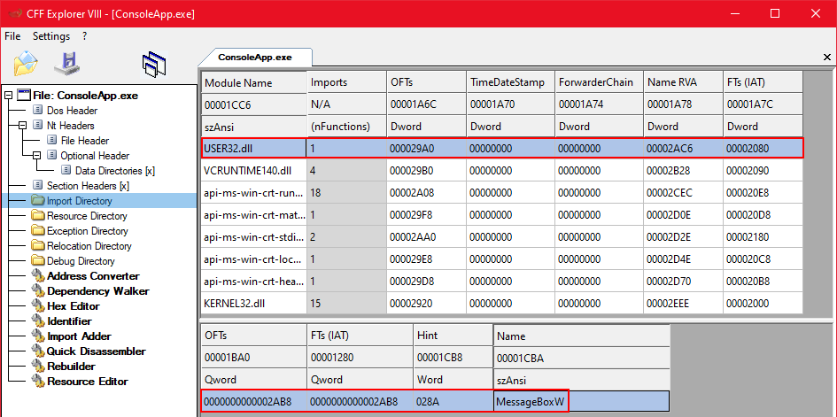
IAT hooking

Slide 9
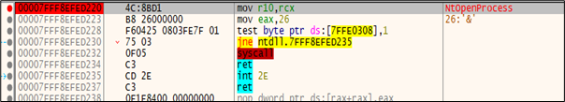
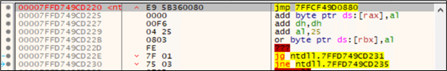
Inline hooking
Normal NtOpenProcess
hooked NtOpenProcess

Slide 10
EDR – Other Telemetry
User Mode
Event Tracing for Windows - ETWEventwrite vs NtraceEvent vs NttraceControl vs Enabletraceex2
Anti Malware Scan Interface – memory patching Amsi functions or sanity checks
Kernal Mode
ETWTI - Event Tracing for Windows Threat Intelligence – eg EtwTiLogReadWriteVm
Kernel Callbacks - eg PsSetCreateProcessNotifyRoutine()

Slide 11

How to write a loader 101

Slide 12
Factors to consider when writing a loader
Static
Programming language
Staged vs non staged
Encryption / encoding
Payload storage
Entropy
Beacon file opsec
Compile it as non console app
Dynamic
No process injections
run time delay
Etw/Amsi patching
Sleep mask
Environment Guard
Removing hooks from ntdll.dll
Module Stomping
No RWX regions
Heavy obfuscation

Slide 13
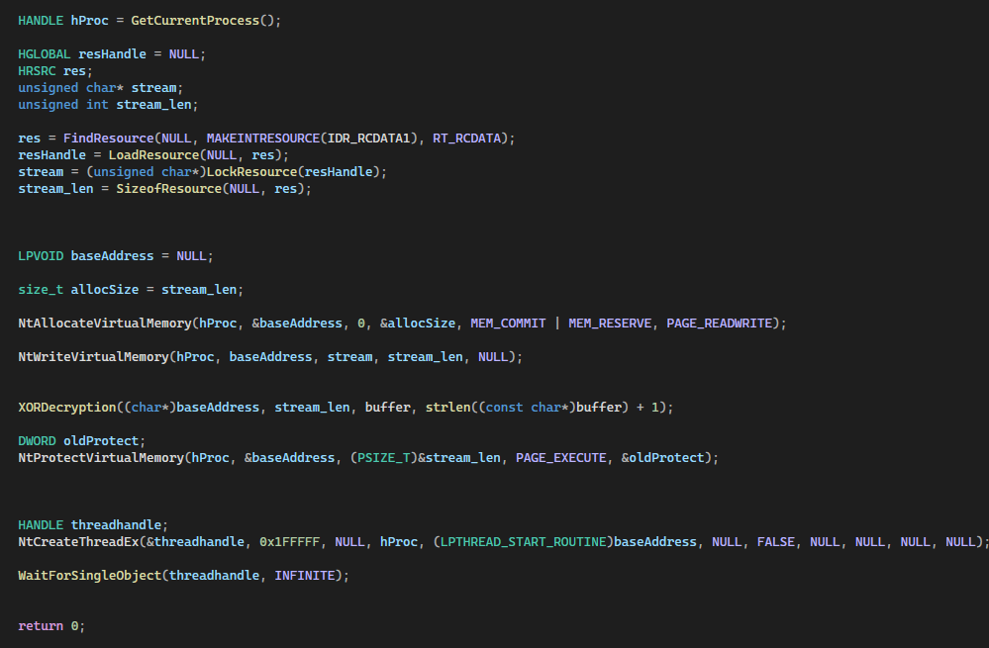
Loader code

Slide 14
Loader demo - regular

Slide 15
Loader demo vs against MDE

Slide 16

Resources
https://cocomelonc.github.io/book/2022/07/16/mybook.html
Sektor7 Courses
Zeropoint RTO and RTO 2
VX Underground
https://wikileaks.org/ciav7p1/cms/page_14587109.html

Slide 17

Questions ?

